Slide 1
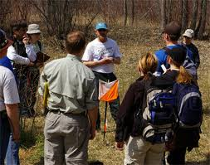
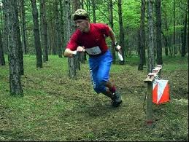
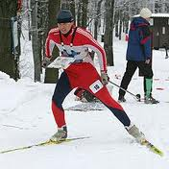
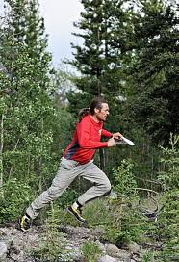
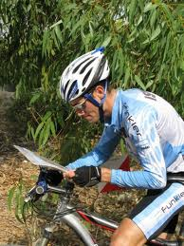
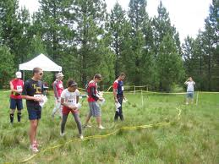
Orienteering
Merit badge

Slide 2
History of the Compass

Slide 3
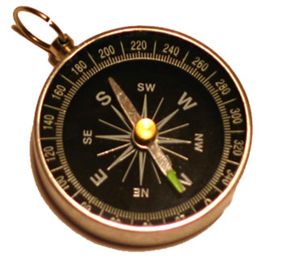
Orienteering history
1919 - Major Ernst Killander (Sweden)
1971 – US Orienteering Federation
Now an Olympic Sport ?

Slide 4
Parts of a compass

Slide 5
Taking a Bearing

Slide 6
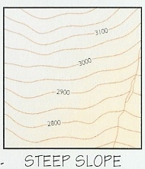
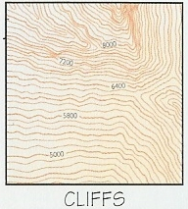
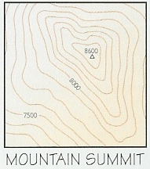
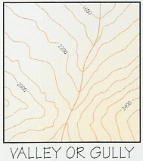
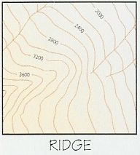
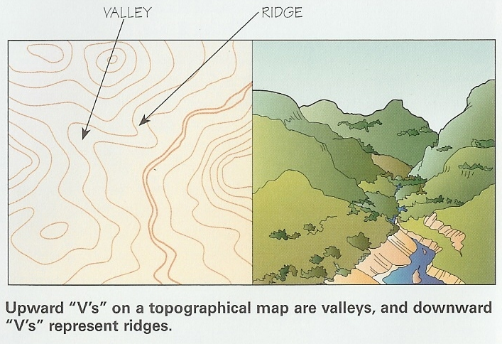
Topographic Maps

Slide 7
Color Code

Slide 8
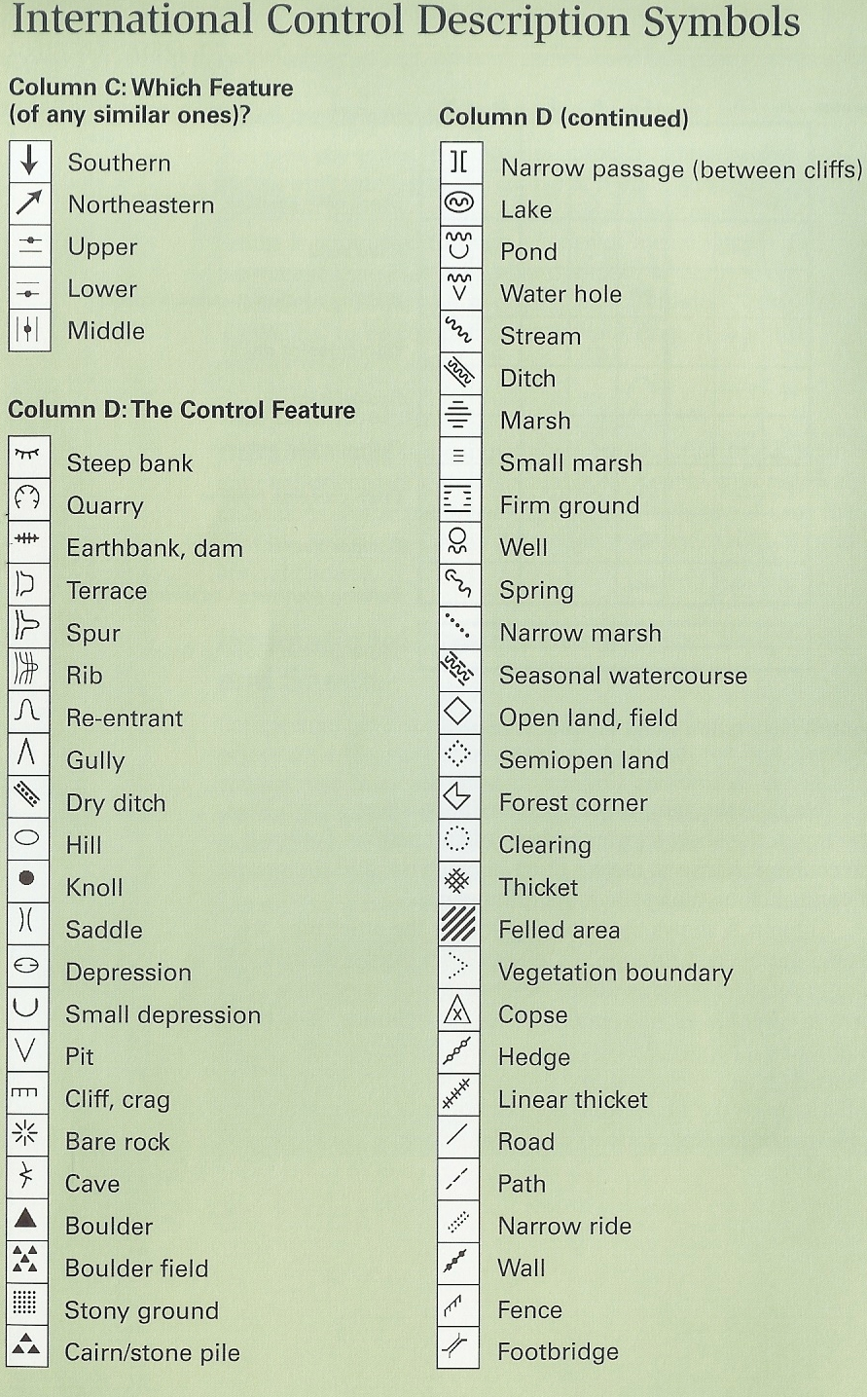
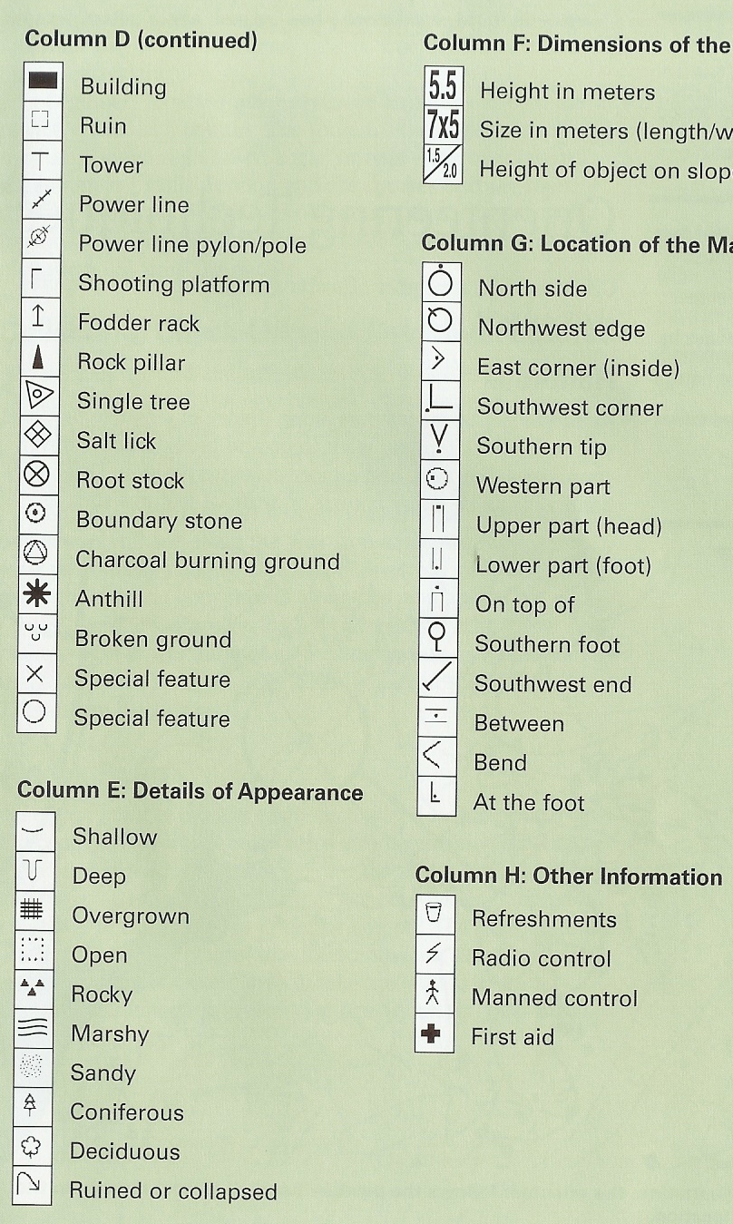

Slide 9
Control description sheet

Slide 10
How to measure the height of a tree or other tall object…
The thumb test…

Slide 11
How wide is the river?

Slide 12
How wide is the river?

Slide 13
Declination

Slide 14
Orienting a map…..
Align bezel so 360 degrees lines up with direction of travel arrow
Determine the angle of declination (see key)
Adjust the compass (+15 degrees in RI)
Align the compass on the map with direction of travel arrow pointing along North-South magnetic lines.
Rotate the map and compass until the compass needle matches the red orienting arrow

Slide 15
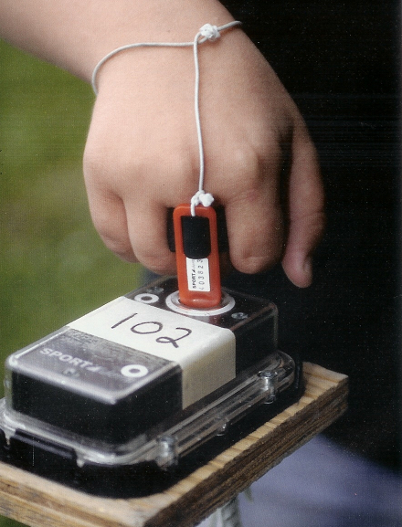
Types of Orienteering

Slide 16
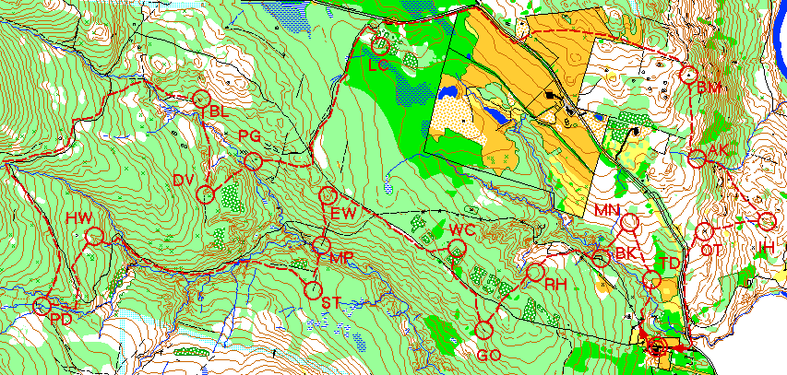
Score Orienteering
Each control has a different point value
Find as many as you can in time allotted

Slide 17
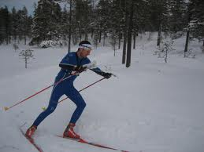
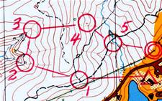
Cross Country
Must visit controls in numerical order
Color coded based on difficulty
Differing length (1.5km – 14 km)

Slide 18
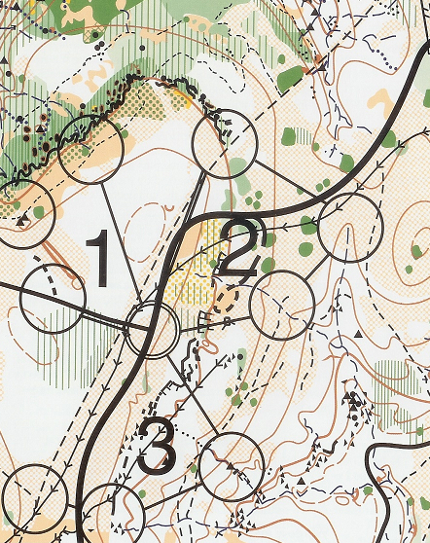
Relay Orienteering
Each team member runs one loop carrying the “baton”
Number of loops depends on number of team members

Slide 19
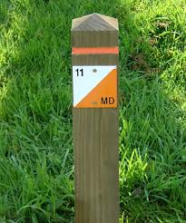
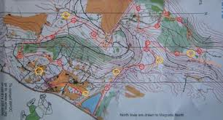
Route Orienteering
Course is marked with colored streamers
Yellow flags beside features
Blue sighting sticks aiming at objects in the distance
Place pin pricks at features, objects
Judged on accuracy

Slide 20
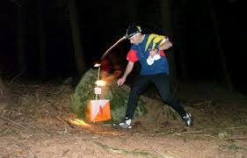
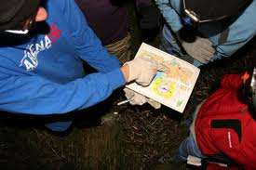
Night orienteering
Competitors wear headlights
Controls marked with reflective tape

Slide 21
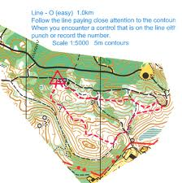
Line orienteering
No controls are marked, only a route
Must follow the route as closely as possible to find controls

Slide 22
Techniques: Handrails

Slide 23
Collecting, Check-Off and Catching Features

Slide 24
Attack Point

Slide 25
Aiming Off

Slide 26
Reading Ahead
Keep a clear mental picture of the terrain you will pass through
At the beginning of the course and after each control
Make sure what you are seeing and what the map tells you match
Don’t move unless you are sure

Slide 27
Contouring

Slide 28
Relocation

Slide 29
“Fight” and Elevation
15 meters of climb = 100 meters on open ground
Vegetable combat = “Fight”

Slide 30
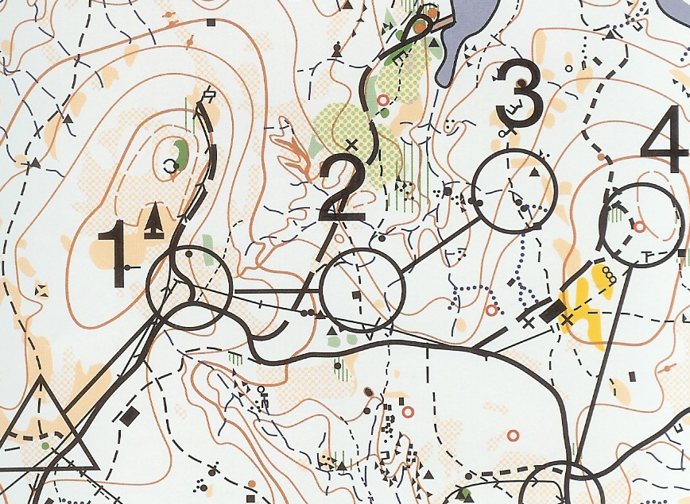

Slide 31
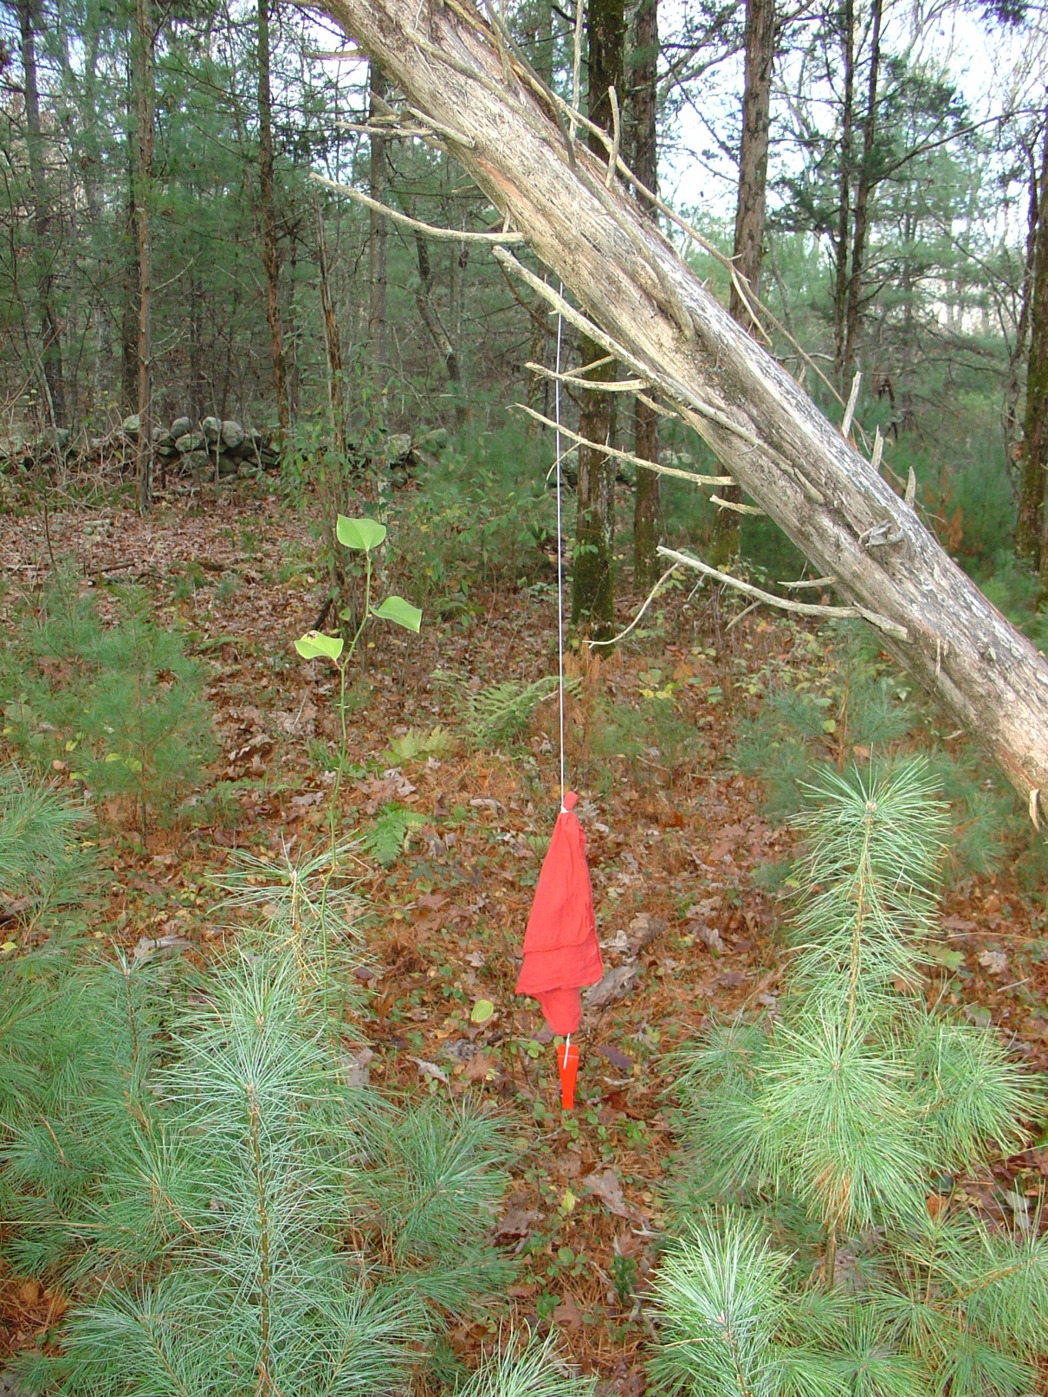

Slide 34
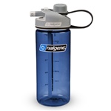
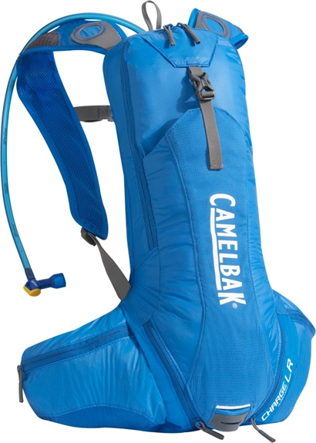
Orienteering first aid
Physical Conditioning
Well-rested, well-fed, physically fit
Dehydration
Drink 1-2 cups 15-20 mins after starting the course and every 15 mins thereafter.
Symptoms of Dehydration are:
Dizziness
Headache
Inability to urinate
Dark urine which may have a strong odor
Dry mouth and nose
Weakness
Nausea and vomiting

Slide 35
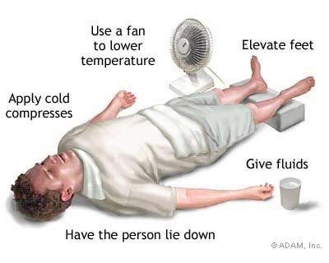
Heat-Related Problems
Heat Exhaustion
Overheated -> cooling methods fail
Increased body temperature (98.6°-102°)
Skin – cool, clammy, heavy sweating
Nausea, weakness, dizziness, fainting
Muscle cramps, headache
Treatment
Position in cool, shaded spot, loosen clothing
Face up with feet raised (pale – raise the tail)
Apply cool, damp cloths to skin or use a fan
Sip water

Slide 36
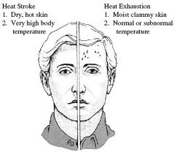
Heat-Related injuries
Heatstroke
Heat control system has failed, temp > 102°
Skin – red, hot and dry, no sweating
Rapid pulse, confusion, fainting, convulsions
Life threatening!
Treatment
Position in cool, shaded spot, face-up with head and shoulders raised (red – raise the head)
Remove outer clothing and soak underclothing with cool water
Apply cold packs, fan or soak in tub of cold water
Obtain medical help immediately

Slide 37
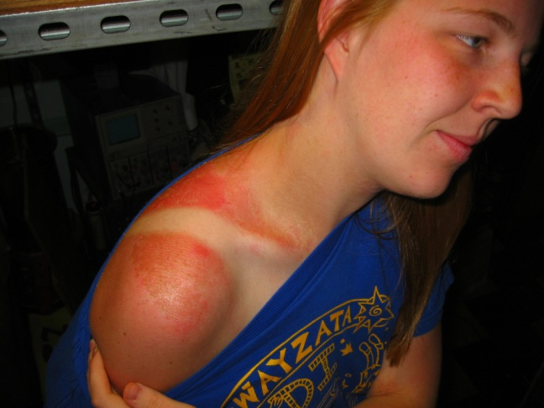
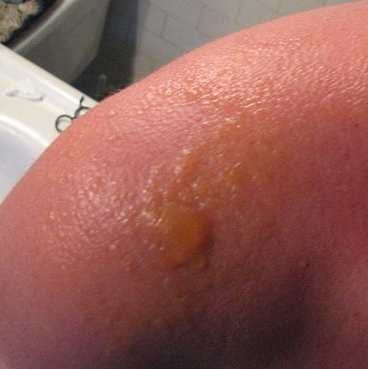
Heat-Related Injuries
Sunburn
skin damage from the sun's uv rays
First degree
Second degree
Prevention
Cover arms, legs, head & neck
Sunscreen at least SPF 15

Slide 38
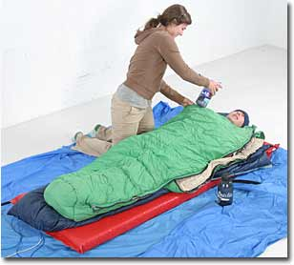
Hypothermia
Can occur in mild weather (cold, windy, rainy)
Prevent by staying warm & dry, eat energy foods
Symptoms
Shivering->irritable, sleepy, disoriented
Unable to think clearly, make rational decisions
Treatment
Get victim warm and dry. Drink warm liquids
Remove damp clothing and wrap in blankets
If severe, Get victim in sleeping bag with 1-2 other people
All should strip clothing
Skin-to-skin to speed warming

Slide 39
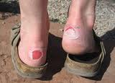
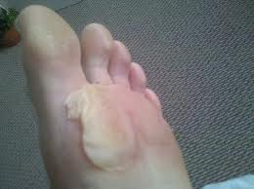
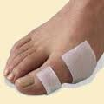
Blisters
Heat - generated from your foot rubbing against your sock which is being pressed by your boot.
Moisture - softens the skin, resulting in less protection. It also reduces the ability of soft socks to smoothly slide on skin, causing more friction.
Grit - sand, dirt, gravel in your boot will increase the friction in concentrated spots, generating more heat.
Prevention:
Dry socks, ‘broken in’ boots that fit well
Treat ‘hot spots’ quickly (moleskin, lube)

Slide 40
Blisters: Treatment
For small blisters:
Apply antiseptic cream directly to the blister and a layer of tincture of benzoin around the wound to help the dressing adhere.
Cut a circular piece of moleskin, Molefoam, or your covering of choice 1/2-inch bigger than the blister. Cut a hole slightly larger than the blister in the middle of the covering and place the "doughnut" over the blister to create a pressure-free pocket around the sore.
Cover the entire doughnut with a second piece of moleskin, then secure it with duct tape. Run tape strips along the sides of your foot toward your toes, then secure the ends with a few loops around the instep.

Slide 41
Blisters: Treatment
To properly drain a large (>1”) blister:
Clean the area with soap and water, alcohol, or an antiseptic towelette. Dry thoroughly.
Sterilize a needle or sharp blade, either by holding it over a flame until it's red-hot or submerging it in boiling water for 2 minutes.
Puncture the bottom end of the blister so gravity can help drain it. The opening should be no bigger than is necessary to get the fluid out. Starting at the top of the blister, massage the fluid toward the opening.
Apply antibiotic ointment to prevent infection, then wrap with the dressing or blister product of your choice.

Slide 42
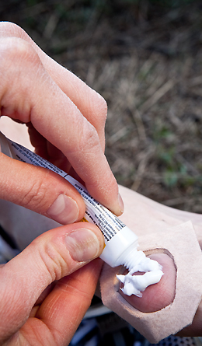

Slide 43
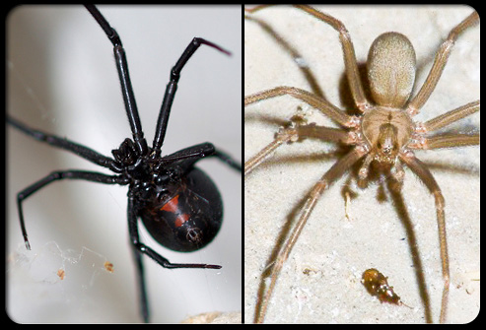
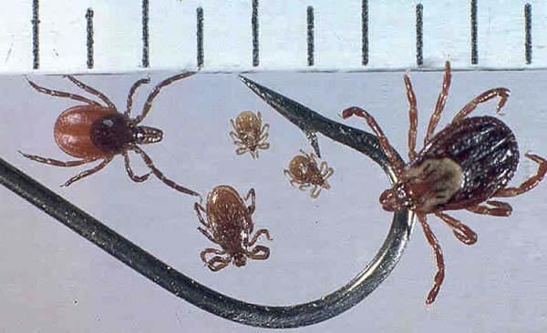
Stings and Bites
Bee stings: remove stinger with knife blade
Venomous spider or scorpion bite:
Ice the site, keep calm
treat for shock
Tie constricting band
between bite & heart
Seek medical help
Ticks:
grasp head close to skin and tease away

Slide 44
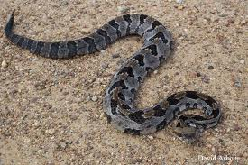
Venomous Snake bite
Venomous snake bite:
Remove rings, watch, tight clothing in area of bite
Keep victim still and calm
Hold wound below level of heart
Treat for shock if necessary
Obtain medical help ASAP

Slide 45
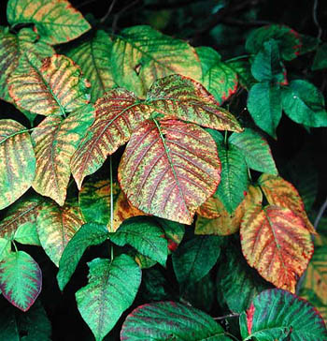
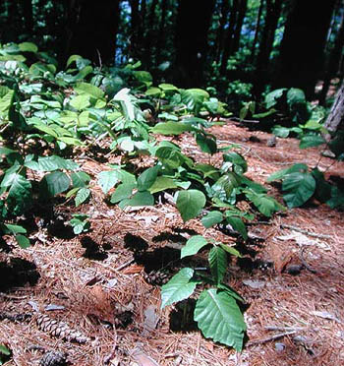
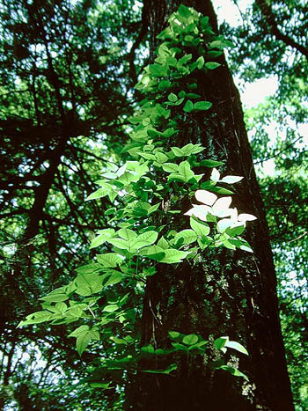
Poisonous Plants: Poison Ivy

Slide 46
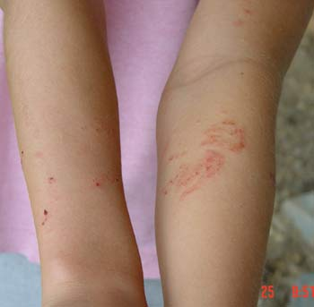
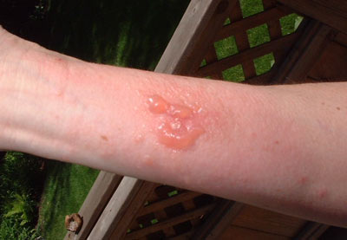
Poison Ivy treatment
Wash sap off with soap and water within 10 mins
Wipe area with rubbing alcohol
Apply hydrocortisone cream
Scratching will cause the rash to spread

Slide 47
Setting up a competition
When will it be?
Where to have it?
What type of competition?
Who will compete?
First Aid Equipment
Safety
Safety lane
Final Return Time

Slide 48
Location of Course
Find an area with existing map
USGS 1:24,000
Forest Service
State Geological Surveys
County and City parks
Create a map
How Long should course be?
OCAD – free program avail online
Familiarize yourself with the area (walkabout)

Slide 49
What to include on the map
Would you hang a control flag on it?
would you use it to navigate? Think of the area from a runner's perspective.
would it impede your progress? The orienteer's goal is to move as quickly as possible between controls flags.
Any object that slows or diverts a runner should be mapped.

Slide 50
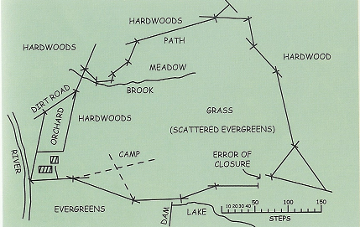
To Begin Mapping
Stand at Starting point
Mark Starting Point
Take compass bearing to 1st point
Place edge of compass on start and turn until N-S lines of compass parallel map N-S lines
Draw line from start, control will lie along line
Walk to control, counting paces.
Place X on map at the control and take compass bearing to next control.

Slide 51
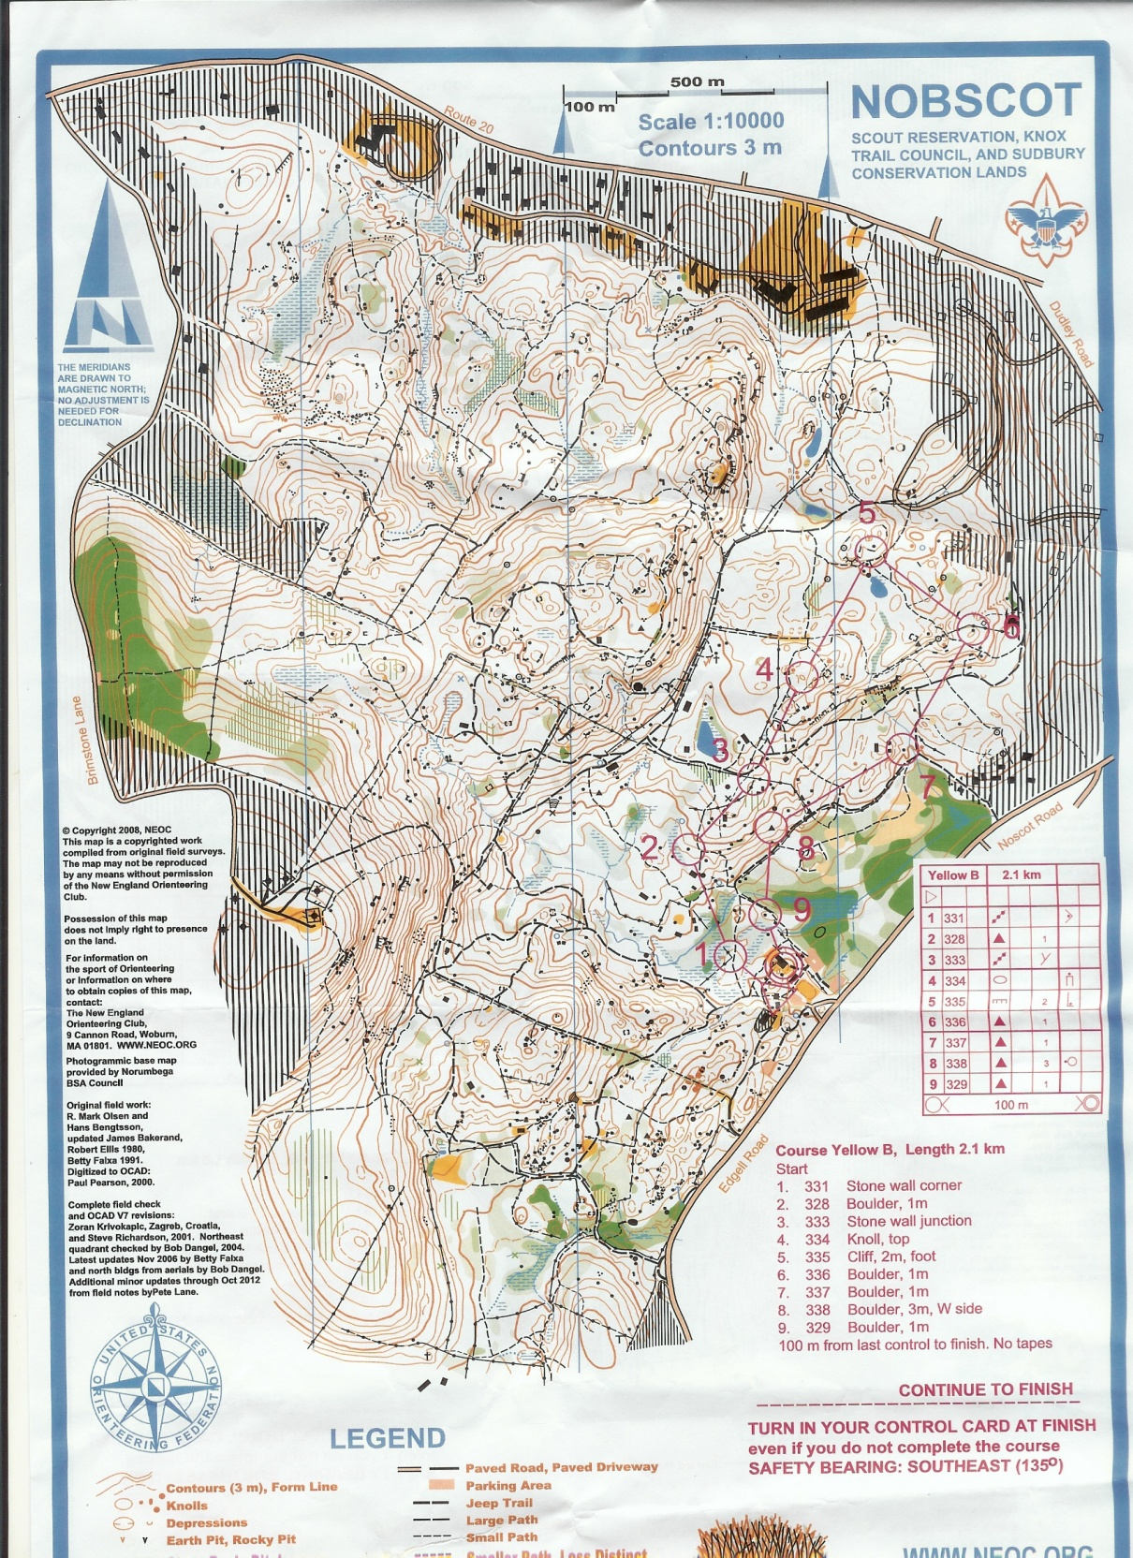
Scout-O
Nobscot
Reservation
Courses:
White
Yellow
Orange

